Slide 1
Change Request Tracker
Presented by Wei Zheng

Slide 2
The purpose of this project is to provide multiple methods for users to submit and track change request through provided applications or email.
A full stack web project.
Features:
Three User Role Types Authentication
Change Request Process Control
Notification Service
Internal Message Service
Third-Party Email Service

Slide 3
Project Map
Front-End
(Applications)
Back-End
(API Server)
HTTP Request
HTTP Response
Post
Display
Interaction
Send
Third-Party Email Service
Users
Send Email

Slide 4
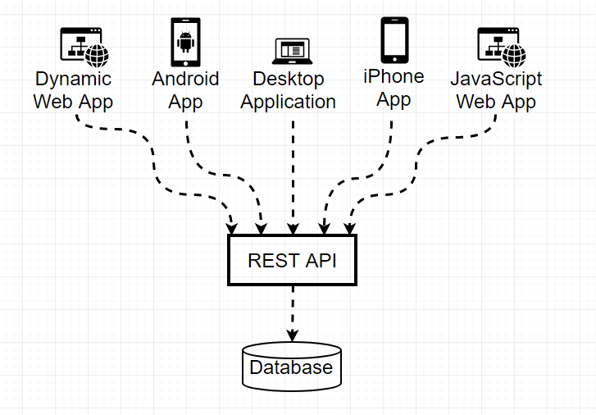
Back-End Layer
RESTful API Server
Build on top of HTTP protocol
Interact with HTTP GET, POST, PUT, and DELETE method.

Slide 5




Back-End Techniques

Slide 6
Server Structure
Presentation Layer
Service Layer
Database Layer
HTTP Request
Handle all business logic
Provide queries to access Database
Resource storage
Controller
Service
Model
Database
Handles all incoming and out going data
HTTP Response

Slide 7
Other Interesting Topics
JWT Token
Multi-Layered Architecture
Object Relational Model vs Plain SQL Query
Cyber Security
SQL Injection
Cross-Site Forgery Request
SOAP vs RESTful API
JavaScript ES6 Promises

Slide 8
API Server

Slide 9

CRViewer
CRViewer is a desktop application written in native Java.
Contains 3 Pages.
Limited feature, but enough for users to view change request.
http://52fffb97.ngrok.io/~weiZ/crt/public/document/crviewer

Slide 10
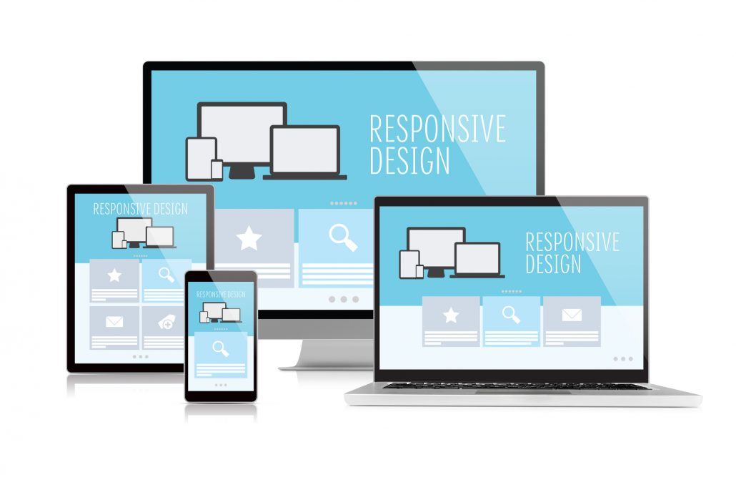
Front-End Layer
Responsive Single Page Web Application
Responsive
page render on a variety of screen sizes
Single Page Application (SPA)
Load content by dynamically rewriting the current page rather than loading entire new pages from a server. This allows smooth transition between views to views, thus, making the application behave more like a native app.

Slide 11




Front-End Techniques
Languages
Frameworks
Axios, JQuery, CKEditor5, vue-js-modal, Datatable, Select2, ChartJS, Bootstrap-Datetime, DateRangePicker, Pace, and etc…
Libraries

Slide 12
Web App Demo
Login User Account
Generate Registration Code
Register User Account
Submit Change Request
Track Change Request
Modify Change Request
http://52fffb97.ngrok.io/~weiZ/crt/public/login

Slide 13


Project Map
Front-End
(Applications)
Back-End
(API Server)
HTTP Request
HTTP Respond
Post
Display
Interaction
Send
Third-Party Email Service
Users
Send Email

Slide 14
Thank you

